Slide 1

A Project
MID-TERM PRESENTATION
ON
‘Hire-Hawk : An Applicant Tracking System’
PRESENTED BY:
SUPERVISED BY:
Mandip Kunwar (5-2-1131-18-2019)
Sagar Rana Magar
Lecturer, Swastik College
Saurabh Subedi (5-2-1131-30-2019)
Shiwam Paudel (5-2-1131-32-2019)

Slide 2

Presentation Outline
Title Slides | 01
Introduction | 03
Problem Statement | 04
Objective | 05
Methodology | 06
Functional Requirements | 07
Project Timing | 08
Tools Used | 09
Diagrams | 10
User Interface | 15
Result | 16
References | 17

Slide 3
Introduction
The "Hire-Hawk: An Applicant Tracking System" simplifies and modernize the recruitment process.
It helps companies to quickly find the right candidates without going through time-consuming and challenging process.
Background
Importance
Scope
Traditional hiring faces challenges with manual screening and subjective evaluations.
Overwhelmed recruiters, time constraints, and a lack of in-depth analysis of resumes.
"Hire-Hawk" addresses these challenges using the cosine similarity algorithm for objective and efficient resume analysis.
Automates screening,
saving time for recruiters and providing a fair chance for job seekers.
Enhances efficiency and
accuracy in matching skills to job requirements.
Revolutionizes
recruitment with a transparent and accessible platform.
Comprehensive online recruitment system.
Effective in Corporate Industries, Human Resource Department & Recruitment Agencies.
Applicant submissions with automated resume analysis.
1
2
3

Slide 4
PROBLEM STATEMENT
a) To address challenges in traditional hiring processes characterized by manual screening and subjective evaluations.
b) To alleviate the overwhelming workload on recruiters dealing with a high volume of resumes.
c) To ensure a transparent and efficient connection between employers and job seekers.

Slide 5
PROJECT OBJECTIVES
To analyse applied applicant resumes and assist HR in the recruitment
To save time by automating the initial screening of resumes
To identify qualified candidates quickly and easily

Slide 6
Methodology
Vectorization
Job Description
Create Job
User Registration
& Authentication
User Resume
Vectorization
Cosine Similarity Algorithm
Applicant Ranking

Slide 7
FUNCTIONAL REQUIREMENT
1
2
3
4
5
Authentication System
User Dashboard
Vacancy Announcement Platform
Job Application with Resume Submission
Score Generator and Hiring Assistance

Slide 8
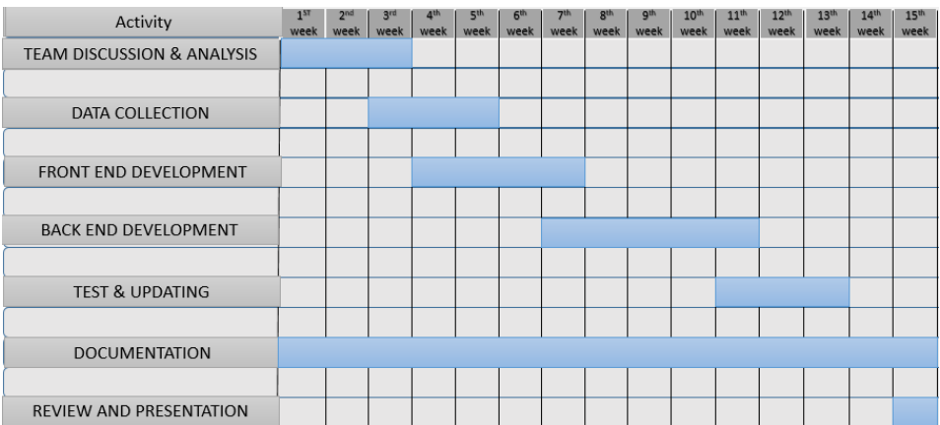
Project Timing

Slide 9
Tools Used
DJANGO
GITHUB
VS CODE
FIGMA
DRAW.IO
OVERLEAF
Web Framework
Version Control System
Code Editor
Designing Tool
Diagramming Tool
Documenting Tool

Slide 10
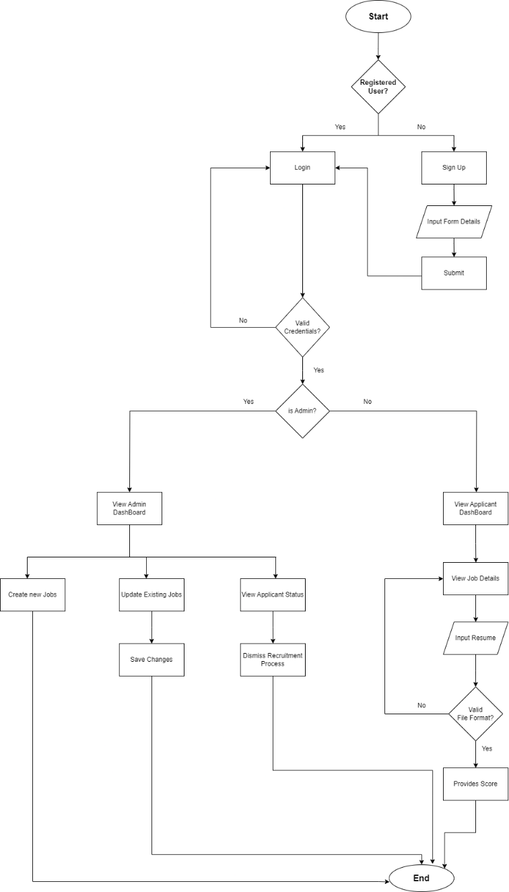
Proposed System Model
Tap to Open Diagram

Slide 11
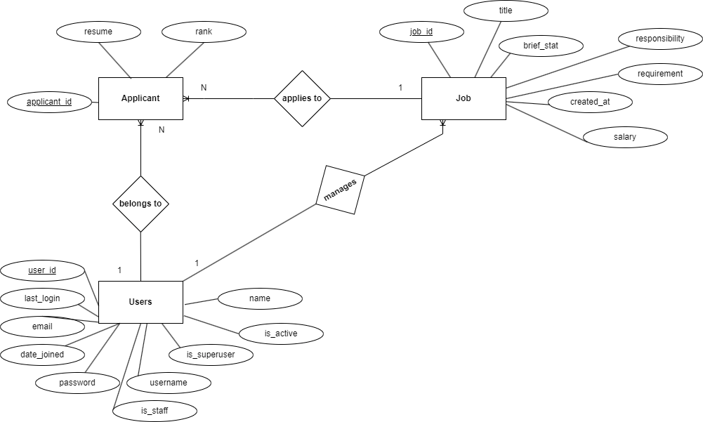
Diagrams
ER-Diagram of HireHawk System
Click to Open ERD

Slide 12
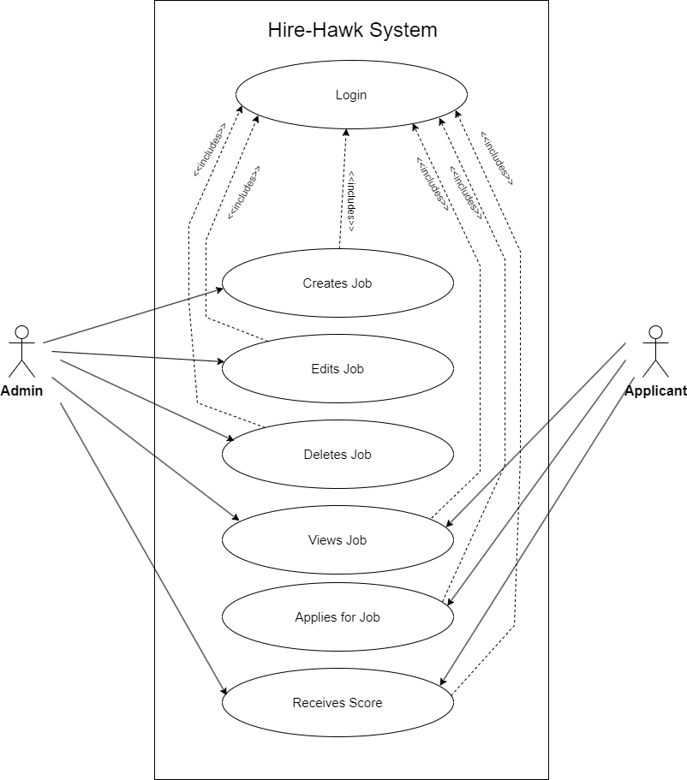
Diagrams
Use Case Diagram
Click to Open Use Case Diagram

Slide 13
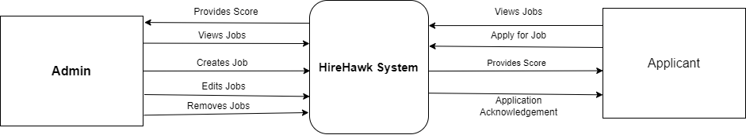
Diagrams
Context Diagram:
Click to Open Level0DFD

Slide 14
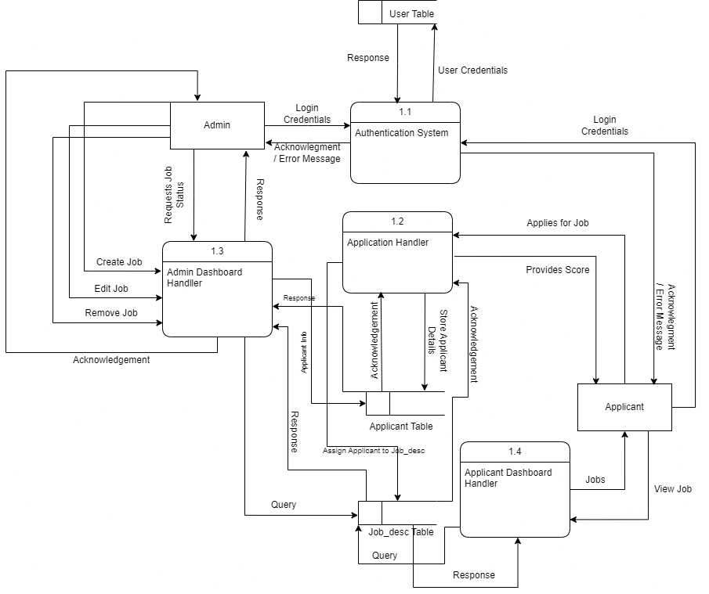
Diagrams
Level 1 DFD
Click to Open Level 1 DFD

Slide 15
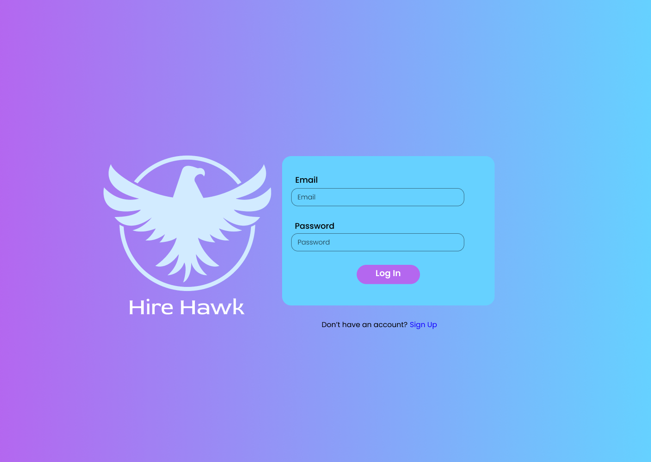
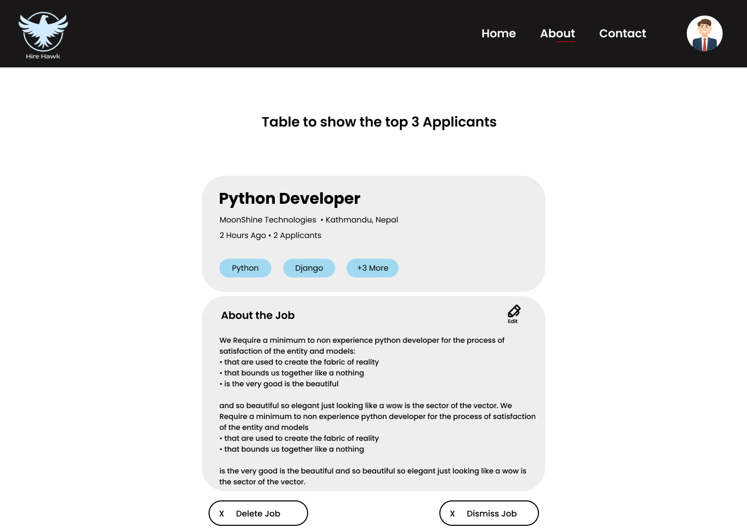
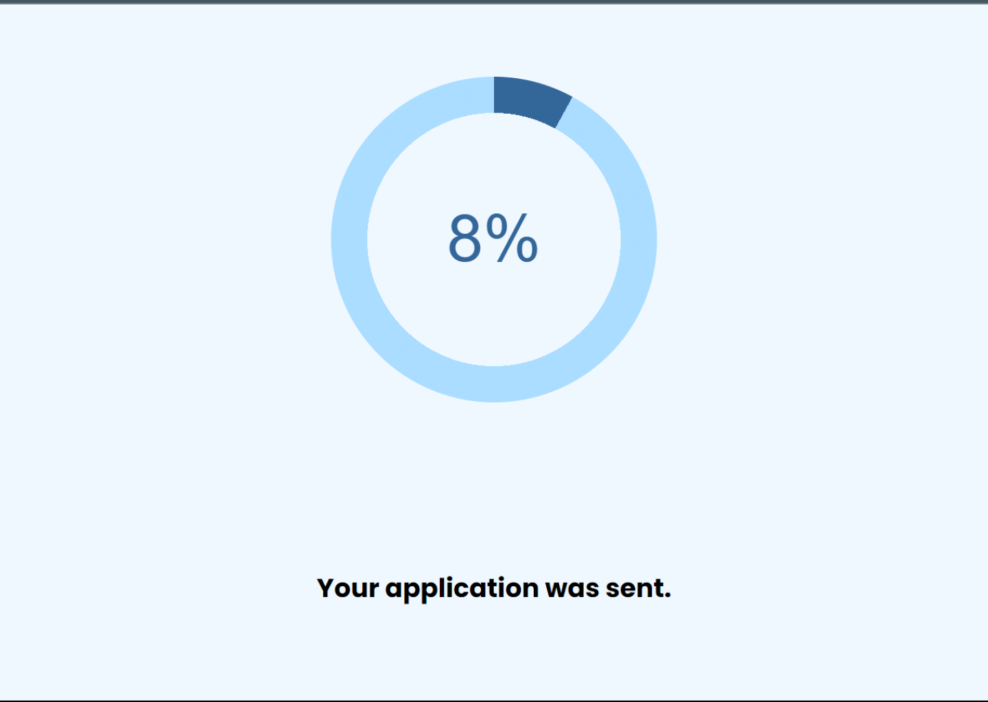
USER INTERFACE

Slide 16
Result
Obtain a ranked list of applicants based on the similarity of their resumes to the given job description.
The system provides a more efficient approach to candidate and job description matching, focusing on relevant qualifications.

Slide 17
References
[1] C. Daryani, G. S. Chhabra, H. Patel, I. K. Chhabra, and R. Patel, “An automated resume screening system using natural language processing and similarity,” ETHICS AND INFORMATION TECHNOLOGY [Internet]. VOLKSON PRESS, pp. 99–103, 2020
[2] H. Braun, “Applying learning-to-rank to human resourcing’s job-candidate matching problem: A case study.” 2017.
[3] A. Zaroor, M. Maree, and M. Sabha, “Jrc: a job post and resume classification system for online recruitment,” in 2017 IEEE 29th International Conference on Tools with Artificial Intelligence (ICTAI). IEEE, 2017, pp. 780–787

Slide 18
Thank you!
Any Questions?

